Slide 1
Saint Barthelemy Biorock:
Growing back the reef crest
Tom Goreau
President, Global Coral Reef Alliance
Sept 20 2023

Slide 2
I’m very sorry that I don’t speak French and can’t be personally with you in Saint Barthelemy.
What Dr. Nathalie Ledee and Tom Farago-Szekeres have just shown you is astonishing, magnificent, the most important coral reef restoration project in the Caribbean, the only one growing back the coral reef crest.

Slide 3
50 years ago St. Jean had a wide, natural beach, not one dredged, pumped, or dumped.
Corals grew right up to the water surface, and you couldn’t swim over the reef.
If Hurricanes broke them, they grew back in years.
In 1979 they died from a disease whose pathogen was never identified.
The reefs, the fisheries, and the beaches never really recovered.

Slide 4
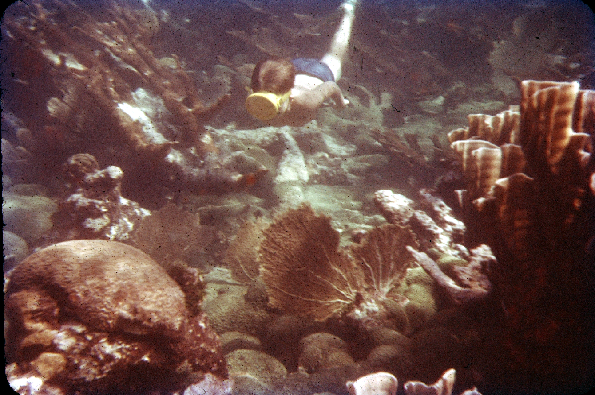
Coral reef devastated by Hurricane Charlie in 1951 5.5 years after:
Ocho Rios, Jamaica, 1957, Photo by T. F. Goreau

Slide 5
Extinction of Caribbean coral reef crests
In 1951, Hurricane Charlie, the worst known to have hit Jamaica at that time, broke corals and flattened reefs around Jamaica, and blew the roof off our home.
Less than 5 and a half years later, it had regrown, as shown in the previous photo.
This no longer happens, the next figure shows places I personally know where the reef crest has disappeared, and beaches are eroding.

Slide 6
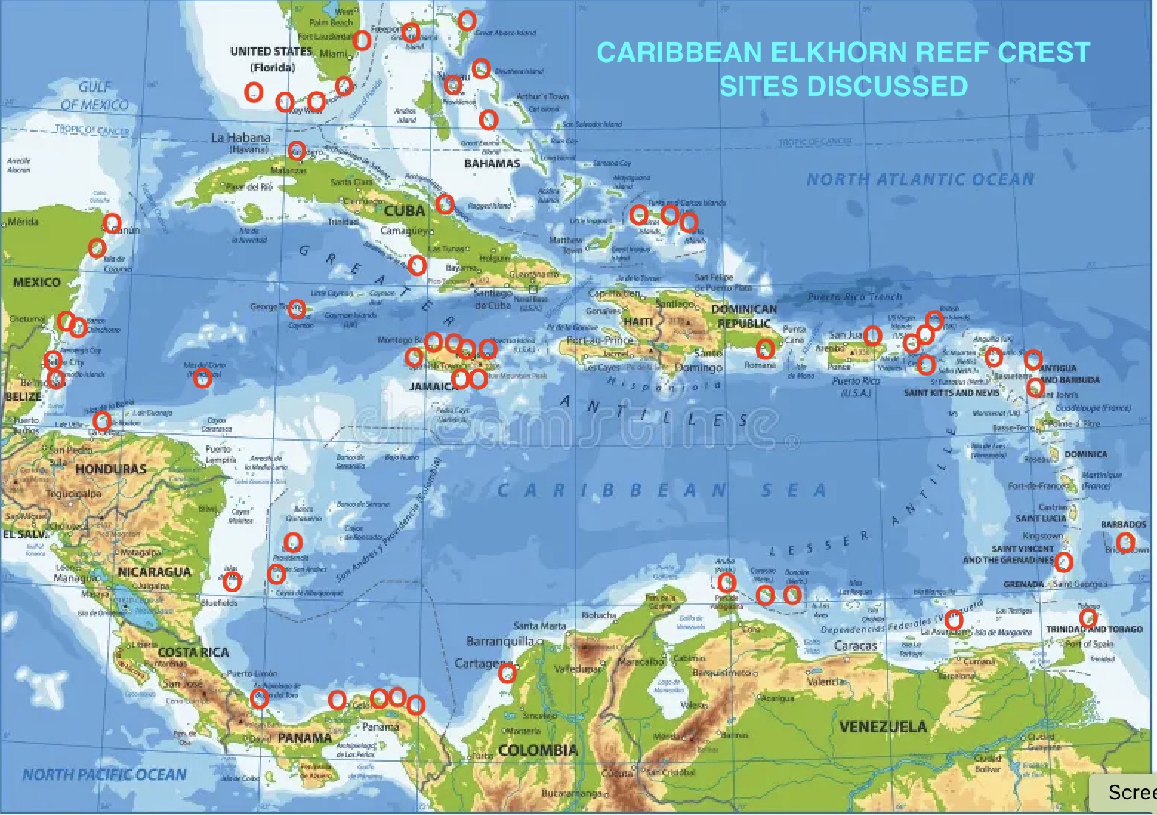
Caribbean coral reef crest extinction

Slide 7
Biorock Electric Reef Technology
Invented in Jamaica in the 1980s.
Increases coral settlement, growth, survival, and resistance to severe temperature stress and pollution, and stimulates all other marine species.
Biorock Electric Reefs have been built all over the world, with most in Indonesia.

Slide 8
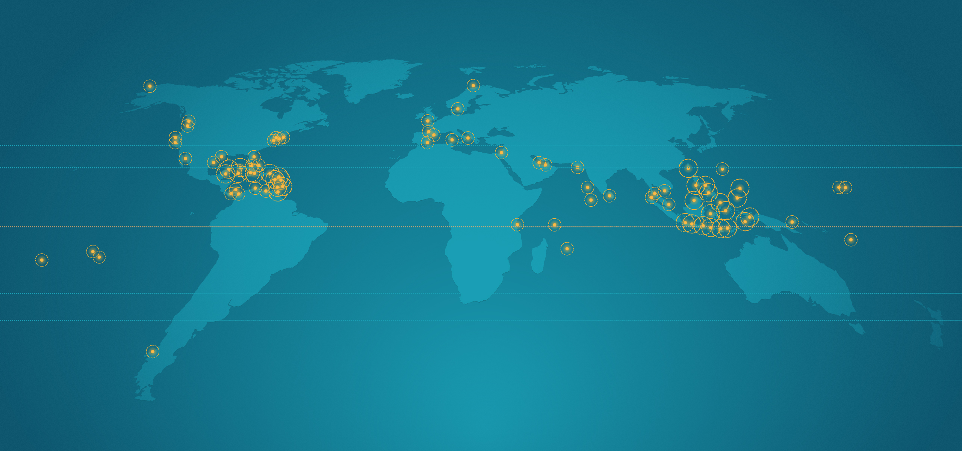
Biorock world projects

Slide 9
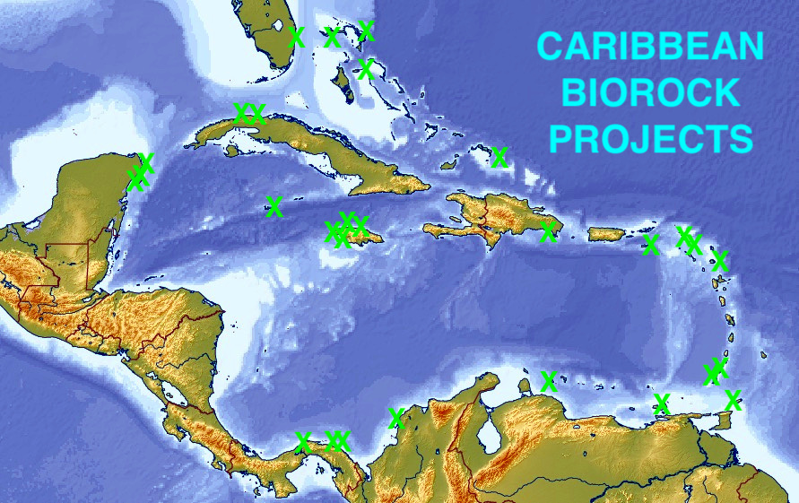
Biorock Caribbean projects

Slide 10
Caribbean Biorock projects
Began in Jamaica, then Panama, and then wherever people realized what they were doing to protect coral reefs was not working, and needed help to regrow them.
The Saint Barthelemy Biorock projects are now the largest and best maintained in the Caribbean, and the first anywhere to grow back the lost reef crest.

Slide 11
Saint Barthelemy Biorock videos
The following short videos of the Saint Jean Biorock project were taken in early 2023 by Juan David Murcia from Puerto Rico, who wrote an independent assessment of the projects with video and photographs (links to the Spanish report and videos are below, a French translation is available from Tom Farago-Szekeres).

Slide 12
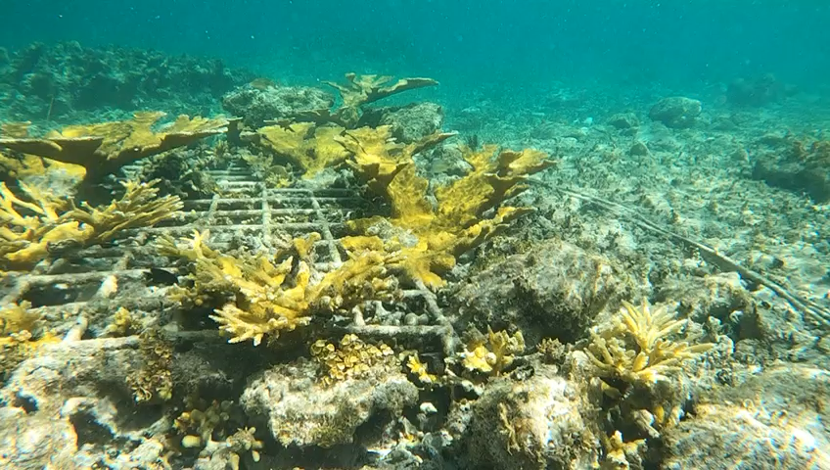
St. Jean, 2023, video Juan David Murcia

Slide 13
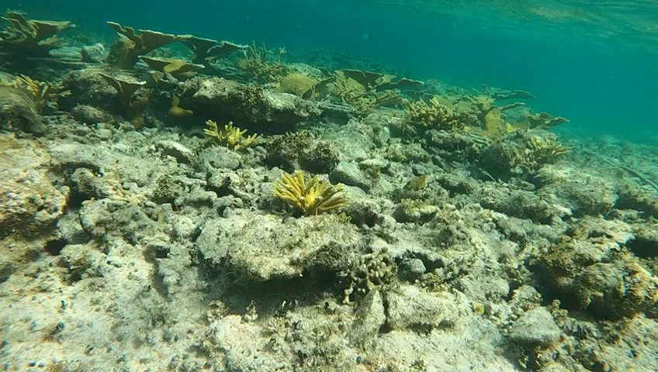
St. Jean, 2023, video Juan David Murcia

Slide 14
RESULTS
These videos show that Biorock corals survived the worst hurricane in Saint Barthelemy history, and are now growing back a new reef crest where the old one used to be, the only place in the Caribbean where this is happening.
These videos don’t show the huge amounts of limestone that have disappeared due to erosion by boring sea urchins, who are grinding down the reef millimeter by millimeter.
Only fast coral growth with Biorock will regenerate the reefs and natural beaches.

Slide 15
The Biorock coral reef can expand to protect all Baie de Saint Jean
The small pilot Biorock project could be expanded to protect all of Baie de Saint Jean, and grow back a natural beach.
Saint Barthelemy already has the scientific, diving, electrical, and maintenance capacity needed in Dr. Nathalie Ledee, Turenne Laplace, Rudi Laplace, Tom Farago-Szekeres, and others to rapidly implement large scale projects.

Slide 16
Coral bleaching emergency
The following image is yesterday’s NOAA satellite Coral Bleaching HotSpot map. Corals in yellow areas will bleach in a month, in orange areas they will die after a month. The entire Caribbean is bleaching severely right now and most coral will not survive except those on Biorock reefs.
Biorock Coral Arks are critically needed everywhere in the Caribbean to regenerate reefs, fisheries, biodiversity, and beaches.
Saint Barthelemy must take the lead, now!

Slide 17
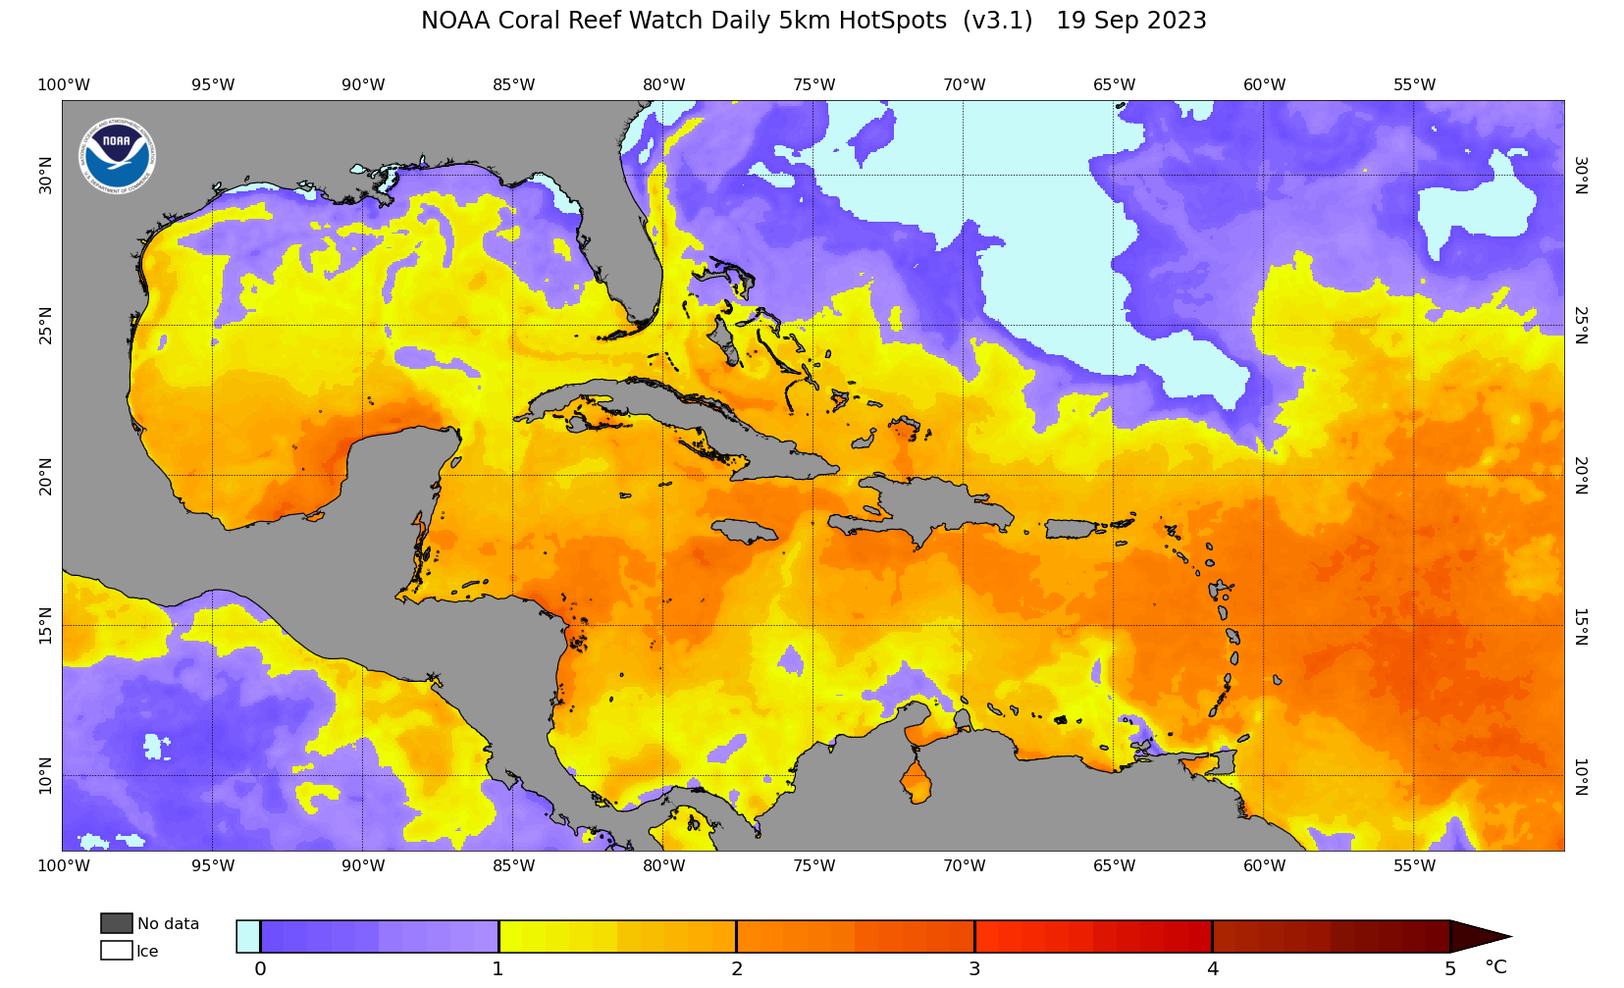
Latest coral bleaching HotSpot map:
Entire Caribbean bleaching

Slide 18
Biorock Saint Barthelemy Report:
https://www.globalcoral.org/biorock-grows-back-saint-barthelemy-reefs-2023-cres-report/
https://www.crespr.org/post/reporte-de-visita-arrecifes-biorock-isla-de-san-bartolom%C3%A9-en-el-caribe-2023
More on Biorock shore protection:
Biorock® Technology for Climate Proofing Beaches, Regenerating Marine Ecosystems, Sustainable Mariculture, Blue Carbon sequestration, climate change adaptation, and producing cheaper and harder carbon-neutral or carbon-negative building materials in the sea.
Side Event at the United Nations Ocean Conference, Lisbon, Portugal, June 30 2022 by Dr. Tom Goreau, Chief Scientist, Blue Regeneration:
https://www.youtube.com/watch?v=6wDwCsxx4Q8

Slide 19
More information:
www.globalcoral.org
www.blueregeneration.com
Goreau@globalcoral.org

