Slide 1
CAPTIVE DOLPHIN WASTES KILL CORAL REEFS
Tom Goreau
President
Global Coral Reef Alliance
International Conference on the Captive Dolphin Industry in Mexico and the Caribbean
Playa del Carmen, Quintana Roo, Mexico
Oct 21 2016

Slide 2
DOLPHIN FACTS
DOLPHINS ARE INTELLIGENT CHARISMATIC VERTEBRATES WHO DON’T NEED PUBLICITY, LIKE CORALS DO!
A DOLPHIN EXCRETES AS MUCH WASTES AS 4-6 HUMANS
A DOLPHINARIUM WITH 10-15 DOLPHINS CREATES AS MUCH SEWAGE AS 20-75 PEOPLE

Slide 3
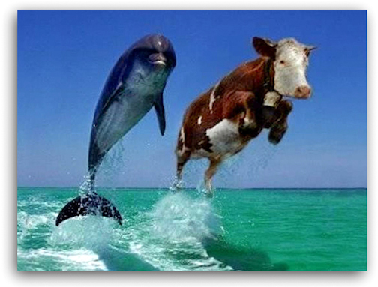

Slide 4
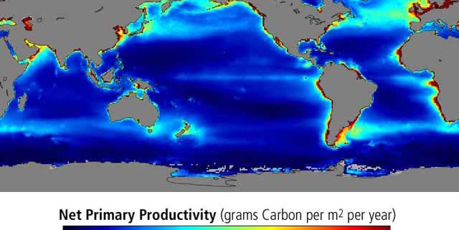
CORAL REEFS REQUIRE PUREST CLEAREST WATERS

Slide 5
CORAL REEF EUTROPHICATION
Coral reefs are the most sensitive ecosystems, they are NOT resilient!
Coral reef ecosystems are the MOST vulnerable of all to high nutrients, sediments, pollution, and temperature
They are killed at levels of pollution so low that no other ecosystem would be affected
Protecting coral reef water quality is the strongest test of sustainable development
Major source of fisheries, tourism, shore protection, biodiversity for >100 countries

Slide 6
CARIBBEAN WATER QUALITY
Every Caribbean country has staked its future on tourism.
Caribbean is the most vulnerable area of the world to coastal eutrophication because of low tides and currents.
Therefore it needs the strongest water quality standards and nutrient recycling on land to preserve its tourism and fisheries

Slide 7
SEWAGE: TOURISM’S DIRTY SECRET
All around the world tourists are swimming in their own sewage, and that of many, many others, too!
I had to swim through a lot of it for this talk!
Coral reefs are the most nutrient sensitive ecosystem, they are smothered by harmful algae blooms at nutrient levels so low that no other ecosystem would be affected

Slide 8
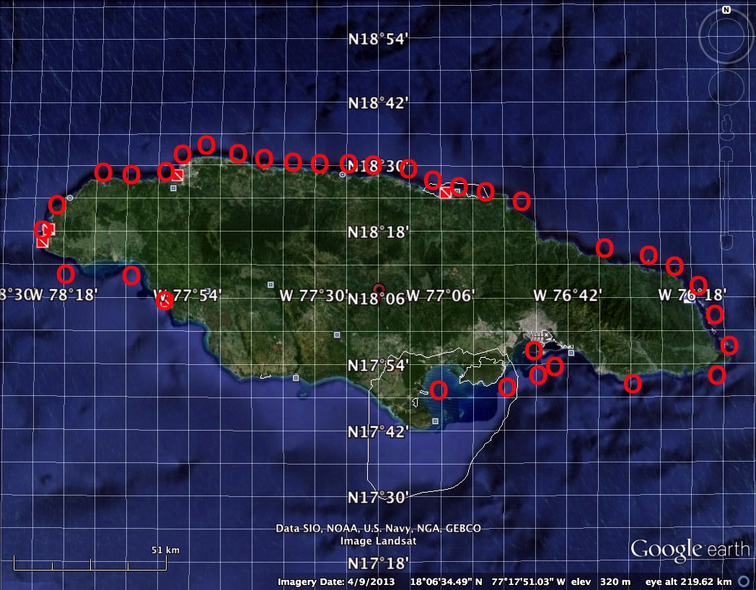
JAMAICA EUTROPHICATION:
PAST, PRESENT, & FUTURE
Tom Goreau, Global Coral Reef Alliance
O
O
O

Slide 9
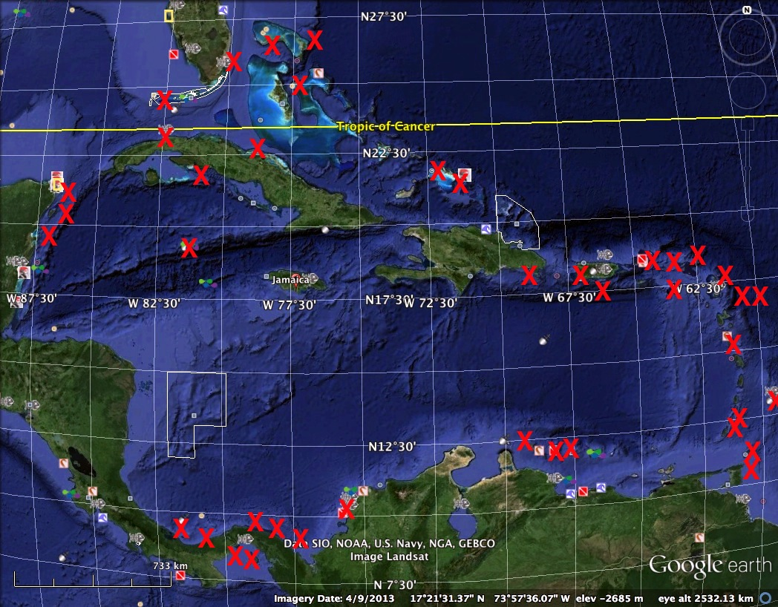
CARIBBEAN EUTROPHICATION

Slide 10
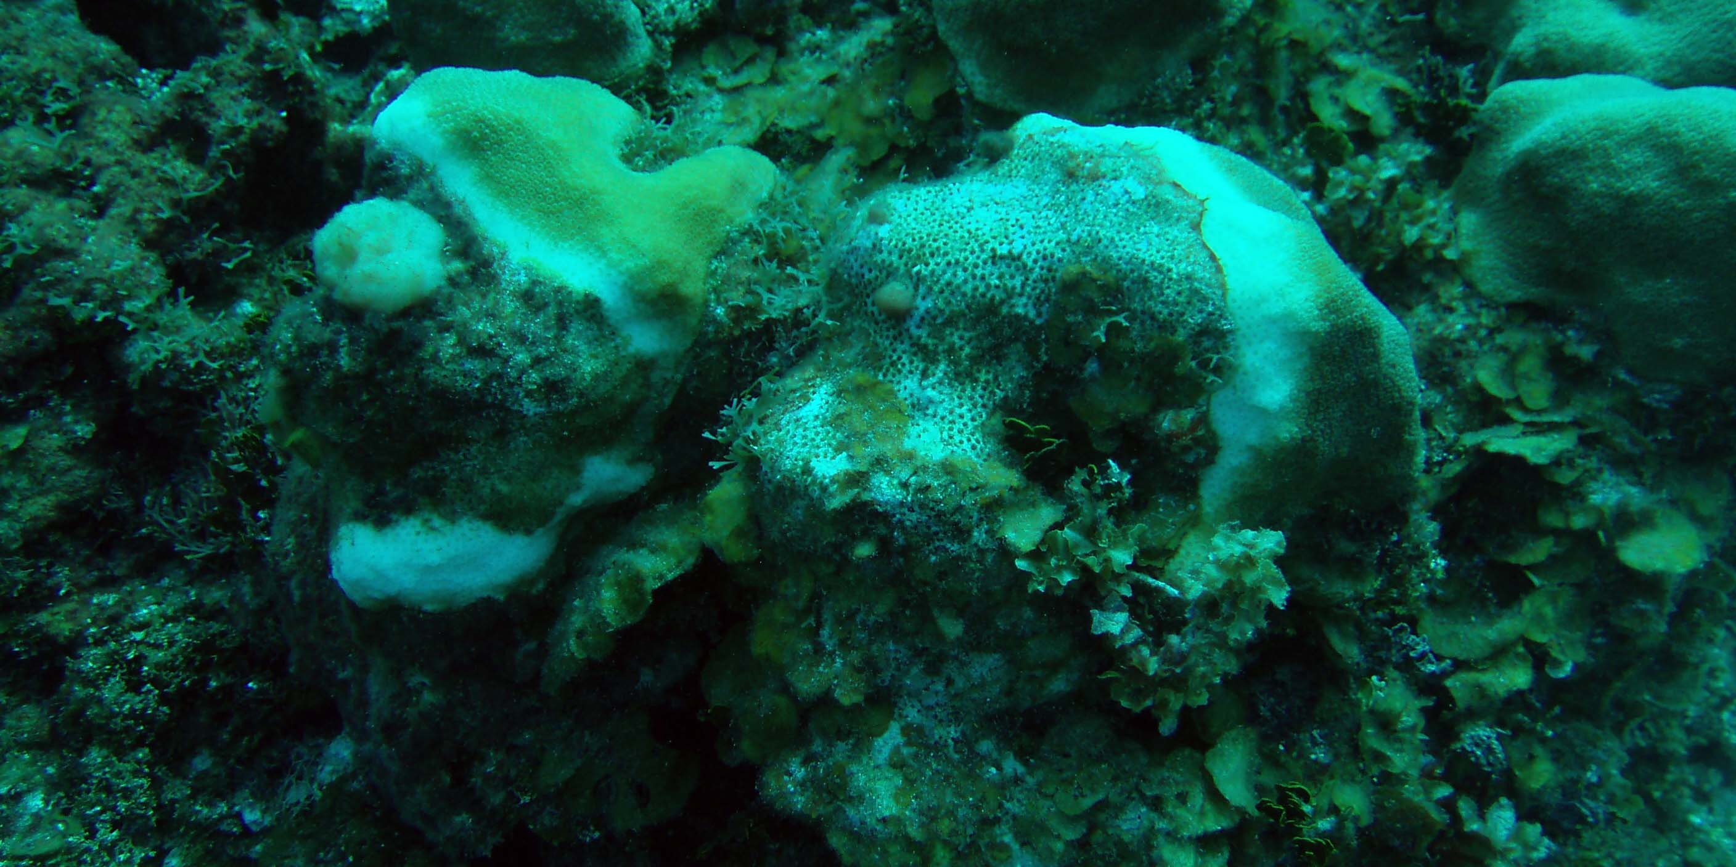
ALGAE-SMOTHERED CORALS

Slide 11
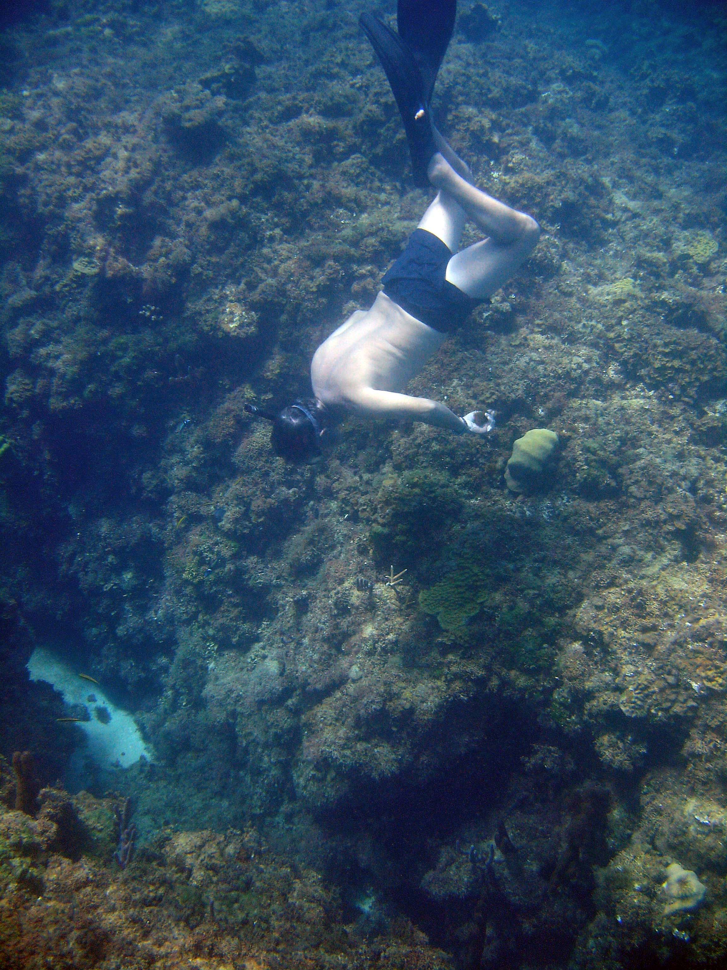
DEAD ALGAE-KILLED CORAL REEFS WITHOUT FISHES

Slide 12
Locations shown on maps are site of many dives (up to hundreds)
Eutrophication = massive overgrowth of harmful algae due to excessive nutrients
Over-fertilized algae smother and kill coral reefs and other marine ecosystems
Suck the oxygen out of water after they rot, causing dead zones, like Kingston Harbour
Nutrients only one factor of land-sea stresses, others include soil erosion, solid wastes, toxic & mutagenic chemicals, and climatically active gases, also need action!

Slide 13
JAMAICA COASTAL WATERS EXCESSIVE IN NITROGEN, NEED ONLY TINY ADDITION OF PHOSPHORUS TO TRIGGER MASSIVE ALGAE BLOOMS

Slide 14
EUTROPHICATION SPREAD
Weedy algae overgrowth of coral reefs begins around major point sources of nutrients, sewer outfalls, drains, rivers, springs, groundwater flows to sea
Starts with algae sharply zoned in concentric rings around sources
Spreads outward from sources and merged until original sources no longer visible
Same patterns world-wide

Slide 15
JAMAICA EUTROPHICATION
Took place over a 50 year period following coastal population development
Driven by nutrient inputs
Caused destruction of reef fisheries habitat, beach erosion
Can only be reversed by ending human nutrient inputs from land

Slide 16
ZERO LAND-BASED NP SOURCE
ALL SEWAGE FERTILIZER EFFLUENT TREATED TO TERTIARY LEVEL WITH FULL BIOLOGICAL RECYCLING OF NUTRIENTS ON LAND
WHY WASTE MONEY IMPORTING FERTILIZER WHILE WE ARE KILLING THE SEA BY OVER-FERTILIZING IT?

Slide 17
ECOSYSTEM SPECIFIC CORAL REEF WATER QUALITY STANDARDS
Based on determining thresholds between coral dominated and algae dominated
Based on the rate of algae growth as a function of nutrient levels
Same limiting values found in Australia, Belize, Florida, Jamaica, Barbados reefs by Bell, Lapointe, Littler, Macfarlane, Goreau, & Hunte

Slide 18
CORAL REEF-SPECIFIC WATER QUALITY STANDARDS
NITROGEN. ONE MICROMOLE PER LITER AMMONIUM PLUS NITRATE, OR 0.014 PPM
PHOSPHORUS. 0.1 MICROMOLE PER LITER PHOSPHATE PLUS DISSOLVED ORGANIC PHOSPHORUS, OR 0.003 PPM

Slide 19
GETTING RID OF WEEDS
The only way to get rid of seaweeds is to starve them of nutrients
They turn pale and die back in weeks
Results are permanent as long as nutrients remain controlled
Dragon Bay, Jamaica, is the only place in the world where this has been done long-term
Hawaii tried and failed

Slide 20
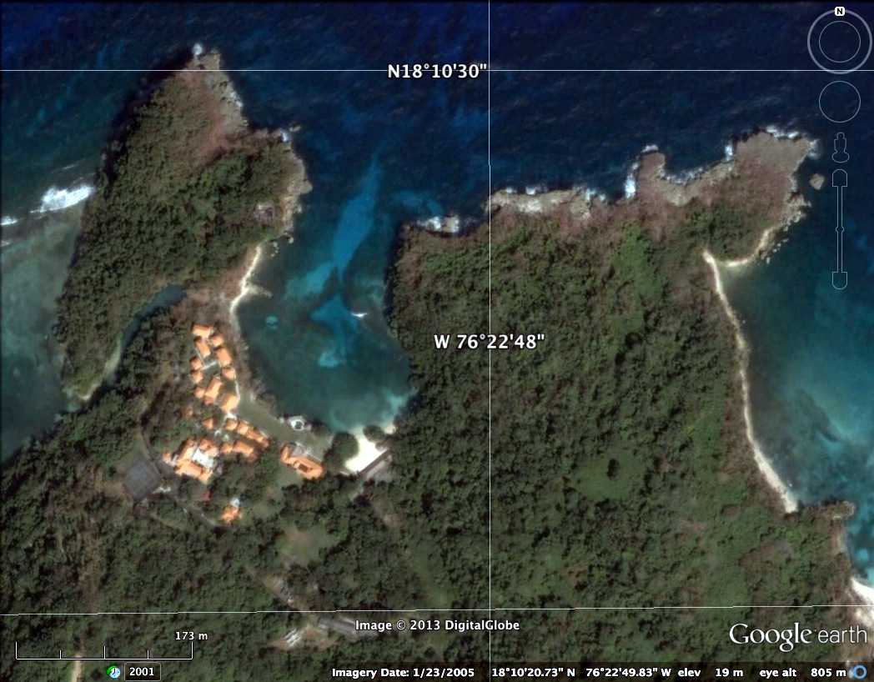
DRAGON BAY, JAMAICA

Slide 21
Dragon Bay had a secondary sewage treatment plant, put effluent in bay where it washed back on beach, turned west side of bay red with weedy algae.
Laundry detergent dumped in river, turned east side of bay green with weedy algae
SOLUTION: Put laundry effluent in sewage plant, instead of dumping effluent on reef, use to water gardens and ornamental plants
RESULT: within weeks algae turned pale and died, gone entirely in two months, coral reef recovered

Slide 22
COASTAL NUTRIENT MANAGEMENT
The core of coastal resource management is nutrient management
No coastal manager in the world has a clue how much nutrients enter their coastal zone, because they don’t have continuous real time nutrient mapping capability
The technology exists but is not being used
Use of these methods will revolutionize coastal management, take it out of the dark ages, and place it on a scientific basis

Slide 23
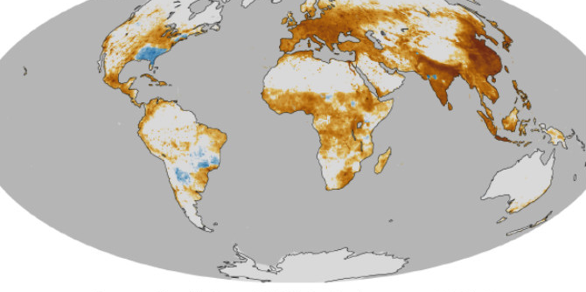
ONLY WHEN WE CAN MAP MARINE POLLUTION AS WELL AS AIR POLLUTION WE CAN IDENTIFY SOURCE AREAS, POLLUTION MOVEMENT, DEFINE POLICIES TO REDUCE SOURCES, AND VERIFY THE SUCCESS OF SUCH POLICIES

Slide 24
TURKS & CAICOS
Every hotel has a package secondary sewage treatment plant and recycles all their waste water on their property as irrigation for ornamental plants.
Propose national coral reef ecosystem-specific nutrient standards for nitrogen and phosphorus
Only country in the world to take these steps

Slide 25
CANCUN: PLANNING AHEAD
Sewage collection system and treatment plants in place before hotels were built
Designed for twice the imaginable amount of development, for 200,000 people
Now more than 1,000,000 live there
20 % of sewage partially treated, rest mostly not at all
Underwater Museum algae-smothered

Slide 26
Cancun is one of very few tourism areas that tried to do the right thing
DID IT WORK?
Impacts of captive dolphins and turtles in Mexico and Grand Cayman

Slide 27
GRACIAS!

